Slide 1
Airlines App – UI Style Guide

Slide 2
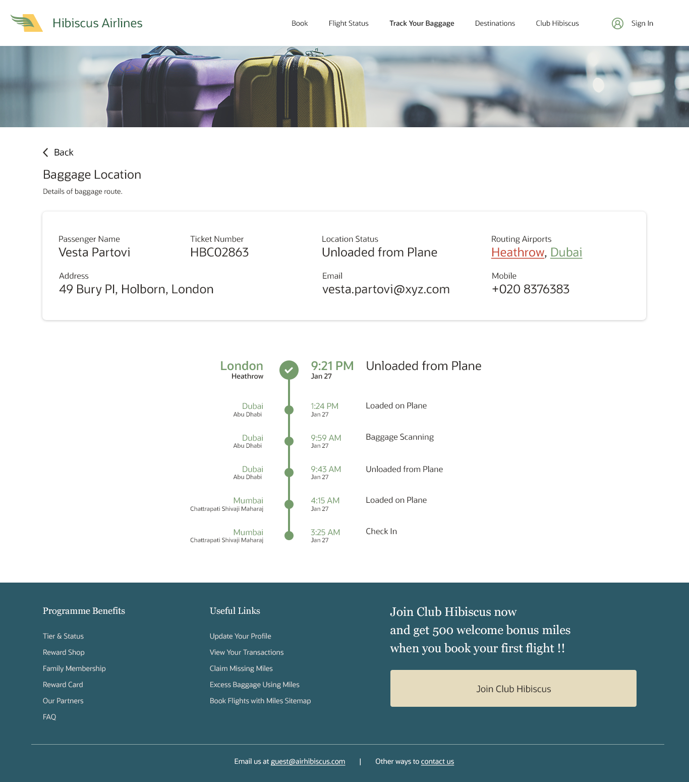
Baggage Tracking - Web

Slide 3
Margins and Dimensions
160px
42px
164px
32px
1198px
215px
84px
80px
80px
164px
72px
396px
488px
84px
1366px

Slide 4
Colors & Typography
Font Size: 14px
Font Family: Oracle Sans Color: #212121
Font Size: 18px
Font Size: 24px (Heading)
Font Size: 14px (Subtext) Color: #212121
Font Size: 16px (Heading)
Font Size: 24px (Subtext) Color: #212121
Font Size: 24px (Heading)
Font Size: 14px (Subtext)
Font Size: 16px
Font Size: 16px (Heading)
Color: #759c6c (Heading)
Font Size: 12px (Subtext)
Color: #212121 (Subtext)
Font Size: 24px (Georgia) Color: #ffffff
Font Size: 18px (Heading)
Font Size: 14px (Subtext)
Font Size: 18px Color: #212121

Slide 5
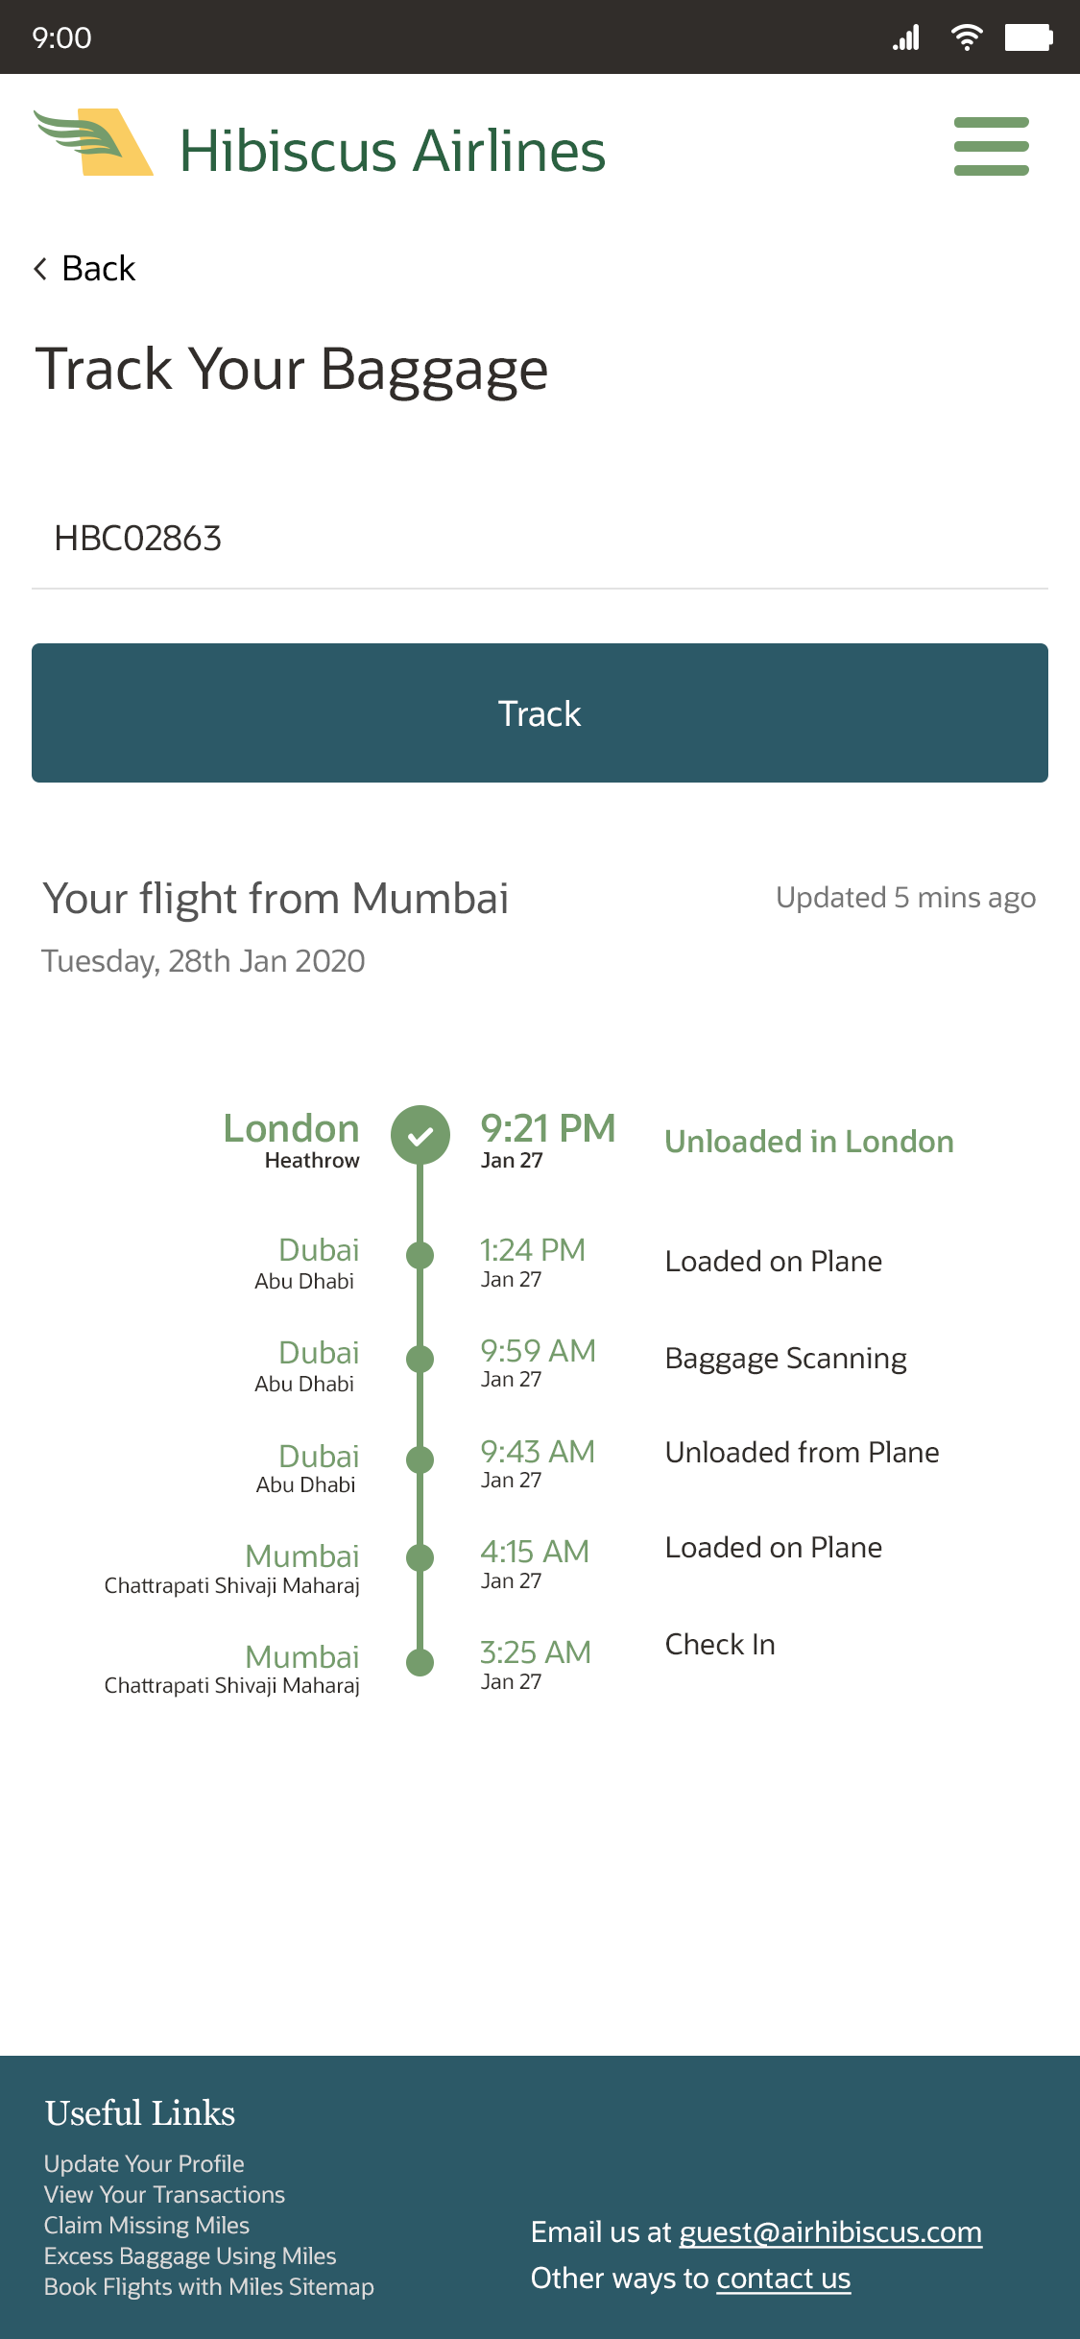
Baggage Tracking - Mobile

Slide 6
Margins and Dimensions
286px
428px
32px
32px
144px
1061px
102px
142px
370px
290px
1125px

Slide 7
Colors & Typography
Color: #759c6c
Font Size: 60px
Font Family: Oracle Sans Color: #212121
Font Size: 36px
Font Size: 36px
Font Size: 36px Color: #ffffff
Bg-Color: #2c5967
Border-radius: 8px
Font Size: 44px (Heading)
Font Size: 32px (Subtext)
Color: #767676 (Subtext)
Font Size: 32px (Heading)
Color: #759c6c (Heading)
Font Size: 22px (Subtext)
Color: #212121 (Subtext)
Font Size: 30px
Font Size: 40px (Heading)
Font Size: 22px (Subtext)
Weight: Semibold
Font Size: 36px (Heading)
Color: #ffffff
Font Size: 24px (Subtext)
Font Size: 30px
NOTE: Use text color #212121 where not exclusively mentioned and default font-family is Oracle Sans.

